Slide 1
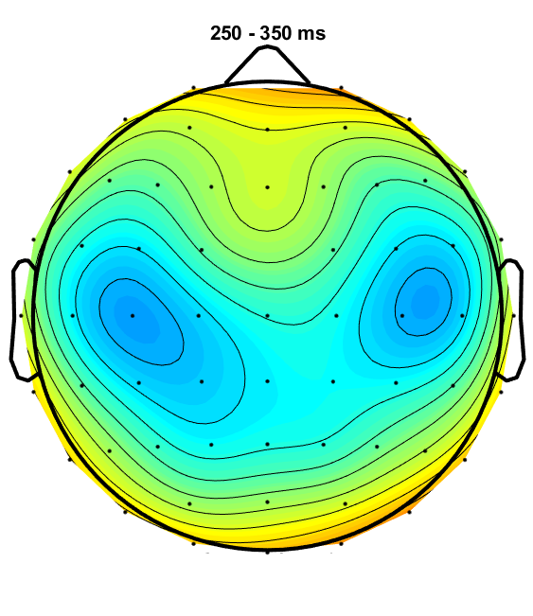
ORN
Young
Old
Old HI
Easy HIT
Difficult HIT
P4
Young
Old
Old HI
Easy HIT
Difficult HIT

